Slide 1
HTML & CSS
Mohammad Sabuz

Slide 2
What is HTML?
HTML is the standard markup language for creating Web pages.
HTML stands for Hyper Text Markup Language
HTML describes the structure of Web pages using markup
HTML elements are the building blocks of HTML pages
HTML elements are represented by tags
HTML tags label pieces of content such as "heading", "paragraph", "table", and so on
Browsers do not display the HTML tags, but use them to render the content of the page
Most latest version of HTML to date is HTML5

Slide 3
New HTML5 API's (Application Programming Interfaces)
The most interesting new API's in HTML5 are:
HTML Geolocation
HTML Drag and Drop
HTML Local Storage
HTML Application Cache
HTML Web Workers
HTML SSE

Slide 4
HTML History
Year | Version
1989 | Tim Berners-Lee invented www
1991 | Tim Berners-Lee invented HTML
1993 | Dave Raggett drafted HTML+
1995 | HTML Working Group defined HTML 2.0
1997 | W3C Recommendation: HTML 3.2
1999 | W3C Recommendation: HTML 4.01
2000 | W3C Recommendation: XHTML 1.0
2008 | WHATWG HTML5 First Public Draft
2012 | WHATWG HTML5 Living Standard
2014 | W3C Recommendation: HTML5
2016 | W3C Candidate Recommendation: HTML 5.1
W3C stands for World Wide Web Consortium.
WHATWG stands for Web Hypertext Application Technology Working Group. This was formed in 2004.

Slide 5
Simple HTML5 Document Structure
<!DOCTYPE html> <html> <head> <title>Page Title</title> </head> <body> <h1>My First Heading</h1> <p>My first paragraph.</p> </body> </html>

Slide 6
Defining Tags
The <!DOCTYPE html> declaration defines this document to be HTML5
The <html> element is the root element of an HTML page
The <head> element contains meta information about the document
The <title> element specifies a title for the document
The <body> element contains the visible page content
The <h1> element defines a large heading
The <p> element defines a paragraph

Slide 7
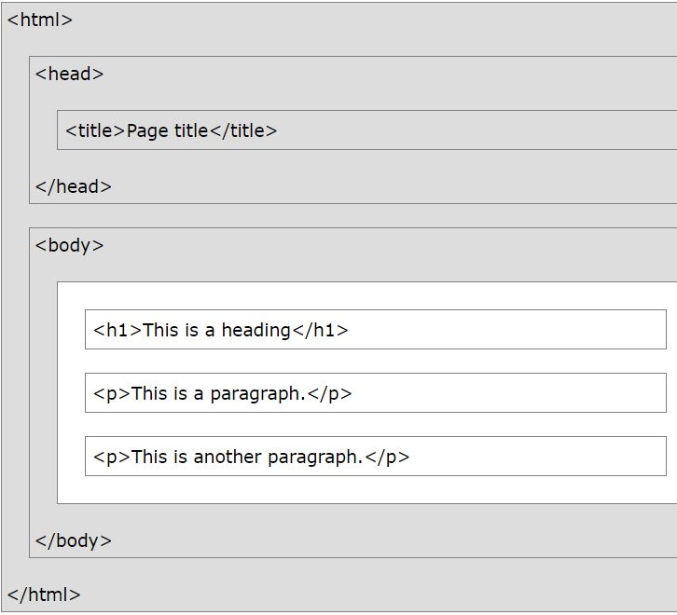
HTML Page Structure

Slide 8
HTML References
https://www.w3schools.com/tags/ref_byfunc.asp

Slide 9
What is CSS?
CSS stands for Cascading Style Sheets
CSS describes how HTML elements are to be displayed on screen, paper, or in other media
CSS saves a lot of work. It can control the layout of multiple web pages all at once
External stylesheets are stored in CSS files

Slide 10
Why Use CSS?
What big problem did it solved?
CSS is used to define styles for your web pages, including the design, layout and variations in display for different devices and screen sizes.
HTML was NEVER intended to contain tags for formatting a web page!
HTML was created to describe the content of a web page, like:
<h1>This is a heading</h1>
<p>This is a paragraph.</p>
When tags like <font>, and color attributes were added to the HTML 3.2 specification, it started a nightmare for web developers. Development of large websites, where fonts and color information were added to every single page, became a long and expensive process.
To solve this problem, the World Wide Web Consortium (W3C) created CSS.
CSS removed the style formatting from the HTML page!

Slide 11
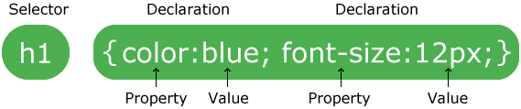
CSS Syntax

Slide 12
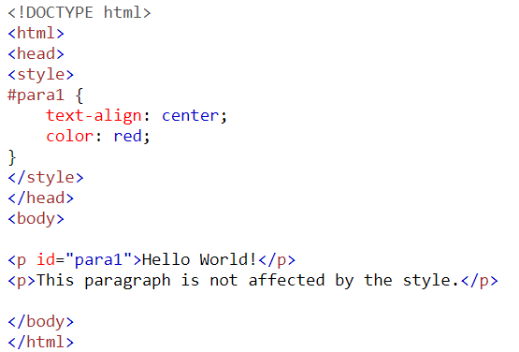
The id Selector
To select an element with a specific id, write a hash (#) character, followed by the id of the element.
The id of an element should be unique within a page, so the id selector is used to select one unique element!
To select an element with a specific id, write a hash (#) character, followed by the id of the element.
The style rule to the right will be applied to the HTML element with id="para1":

Slide 13
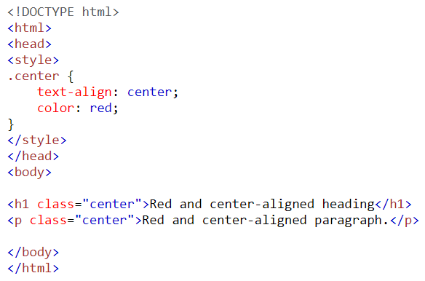
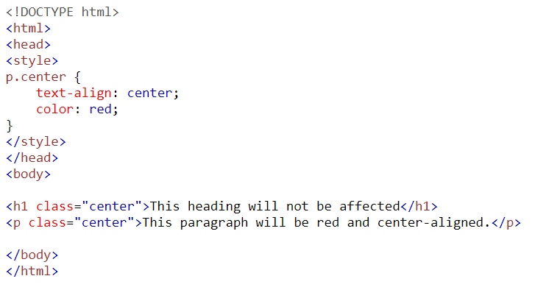
The class Selector
The class selector selects elements with a specific class attribute.
To select elements with a specific class, write a period (.) character, followed by the name of the class.
In the example to the right-side, all HTML elements with class="center" will be red and center-aligned.
We can also specify that only specific HTML elements should be affected by a class.
In the example below, only <p> elements with class="center" will be center-aligned

Slide 14
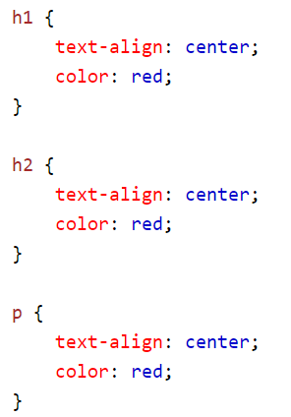
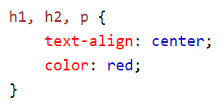
Grouping Selectors
It will be better to group the selectors, to minimize the code.
To group selectors, separate each selector with a comma.
In the example to the right you can see how we grouped the selectors.

Slide 15
How to Insert CSS?
There are three Ways to Insert CSS
External style sheet
Internal style sheet
Inline style

Slide 16

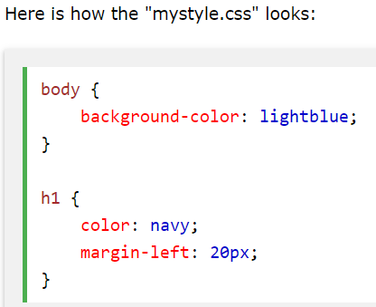
External Style Sheet
With an external style sheet, you can change the look of an entire website by changing just one file!
Each page must include a reference to the external style sheet file inside the <link> element.

Slide 17
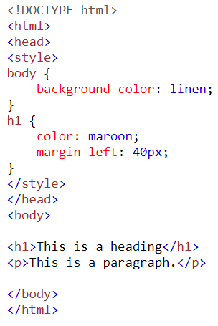
Internal Style Sheet
An internal style sheet may be used if one single page has a unique style.
Internal styles are defined within the <style> element, inside the <head> section of an HTML page.

Slide 18
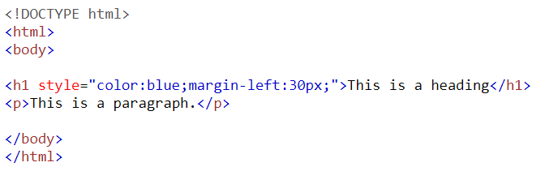
Inline Style Sheet
An inline style may be used to apply a unique style for a single element.
To use inline styles, add the style attribute to the relevant element. The style attribute can contain any CSS property.
The example to the right shows how to change the color and the left margin of a <h1> element.

Slide 19
CSS References
https://www.w3schools.com/cssref/default.asp

Slide 20

Let’s create a simple website with HTML and CSS

